Slide 1
SHAKIR ALI
(1916—1975)
“Art in Pakistan”
BFA-IV (Visual Arts)
Class Incharge: Ms. Farah Khan
Institute of Design & Visual Arts, LCWU

Slide 2
SHAKIR ALI
Shakir Ali is considered to be the pioneer of Modern art in Pakistan. He is also acknowledged as the father of cubism for bringing its seeds on the land of Pakistan after post-partition period.
He was one of the most celebrated artists and art teacher and was well equipped with both the knowledge of eastern and western art. He remained the principal of the National College of Arts in Lahore, from 1962 onwards for a long time and did a lot of effort to develop and modernize Institution. He had a huge following of students, many of whom later became well-known artists in Pakistan.
Shakir Ali was born in Rampur India in 1916, he did his masters from Jamsetjee Jeejebhoy (JJ) School of Arts Bombay, where he got the change to study and understand the indigenous art of India and his practice of that time also reflected the same local vocabulary of image making. Later on, he went abroad for gaining further training in art at the Slade School of Fine Art, London, and then in France and Prague. He stayed there for four years (1946-49) and got the chance to explore the modern vocabulary of art making developed during 20th century.
He developed his pictorial vocabulary by observing people and places and drawing and sketching birds and flowers in Paris and Prague, he developed the significant motifs of birds, flowers and sun which appeared in his works under a specific content. Those visits left an enormous impact on his style of painting as well as on the development of concepts behind his artistic endeavors.

Slide 3
SHAKIR ALI
Shakir Ali acknowledged this fact in an interview and said,
“I used to go to draw the live Baroque birds to the Prague Zoological Gardens; I made my first bird sketches in Prague and they and flowers have never left me since”
Before shedding light on the artistic expression of Shakir Ali developed after receiving advanced education in the west, it is important to have a critical understanding of 20th century that witnessed a rapid series of artistic inventions in its first two decades which arose to mark a difference from the past. The advent of cubism marked a period of radical revolution in the arts, with a rapid spread of artistic innovations and a great diversification of styles and techniques. Of all the revisions of pictorial language proposed in 20th century, cubism has been the most radical.
The leading artists of Cubism were Pablo Picasso and Georges Braque. Shakir Ali got the chance to see their work personally and also fell under the influence of cubism. He also worked with an abstract artist, Andre Lhote from (1949-1950). He was more inclined towards using abstract compositions in his work using the vocabulary of Cubism. The concept of abstraction is based on graphic construction of imagery. He was also having great understanding of design because he remained for two years (1950-1951), at the Industrial School of Design, Prague. This variety of experiences enriched his sense of organization towards using his surface of canvas.

Slide 4
SHAKIR ALI
Shakir Ali synthesized a 20th century cubist style with the elongated forms of Modigliani (1887-1920) and gave birth to a group of followers of abstract ideas of the west after returning back. Shakir Ali went to Karachi, remained their for a short span of time and then moved to Lahore. He was appointed as a lecturer at the National College of Arts. He was the first individual on the art with modern approach towards the esthetical values of his imageries and who had the most influence on the art movement of the fifties. Shakir Ali’s presence in Lahore acted as a moving force to the art society for his overpowering interest in the works of Cezanne (the driving force behind the philosophy of cubism) and cubism, which he introduced in the 1950s.
His expedition and mental wanderings through history became the source of maturity in his style and subject matter. His still lives, floral motifs, boats, bulls and human figures, particularly female as amorous state were painted in cubist manners. His early work was executed in the manner of Braque. He painted many Braque-like still life’s such as Still life with apple, Still life with bottle of Chianti, Still life with fruit. The first was most characteristic of his style in which the apple was hardly noticeable while the picture was divided into many areas with straight lines and a few curves and each area differently colored to make a puzzling pattern in which the big jug and the apple get lost.

Slide 5
SHAKIR ALI
Shakir Ali’s imaginative distorted patterns of space, the calculated juxtaposition of color and audacious employment of textures, were a departure from the familiar and recognizable approach. Shakir used rhythmic curved line and exiting colors which are compelling to the eye and intellect.
By the late fifties, Shakir began to move away from cubism and his paintings became more complex, stylized and bigger. From a European viewpoint, there was nothing new, original or noteworthy about these paintings, but for Pakistan he was the first painter with first-hand experience from abroad to paint in a ‘modern’ western manner. Many young artists came under his influence and modern vision became the fashionable mode attempted by many of the artists. This new trend gave courage to the young artist to break away from the academic styles and to work with the modern idioms.
Shakir Ali’s ideas and artworks have served as an inspiration for generations of artists and he was among the pioneers to introduce modern art to Pakistani artists. “Shakir’s biggest contribution was to localize the foreign and western art by blending it with the indigenous. He was the one to fuse the local themes and issues as well as deep rooted traditions in the contemporary art of his time. He continues to inspire upcoming artists with his remarkable work and vision.

Slide 6
SHAKIR ALI
He became a professor at the Mayo School of Art and later on promoted as principal in 1961. Being a teacher his potential to manipulate the art scene in Pakistan was unlimited. He got a special opportunity to influence the young artists of Lahore.
“His social and friendly nature brought him near to a group of young painters who were searching for means to express their personal and unique mode of existence”. A new horizon of thinking in abstract manner was opened in the history of Art in Pakistan by Shakir Ali. He trained a number of Pakistani artists and made “cubism” synonymous with “Modern” and “progressive” and highly influenced the later generation of Pakistani artists. Prominent artists of the later period showed a great influence from Shakir Ali. Among them were Ali Imam, Moen Najmi, Sheikh Safdar, Ahmed Pervez, Anwar Jalal Shemza, Qutub Sheikh and Raheel Akber Javed.
“ Shakir Ali not only influenced but also subtly guided painters like Shemza, Ahmed Pervez, Safdar, Moen Najmi, Ali Imam and many others by his views and philosophical discourses on modern art”. This group of intellectuals with progressive approach formed Lahore Art Circle and left a strong mark on the history of Pakistani art through their progressive approach of making art and they initiated novel horizons for the next generation.

Slide 7
SHAKIR ALI
Dr Akbar Naqvi, an eminent writer and art critic, in his book, Image and Identity, gave them the title of Shakir Ali’s Panj Piyare (meaning ‘the five beloved ones’ in Punjabi).
These young artists adopted contemporary styles that varied from Impressionism to Expressionism, Cubism, and Abstraction. Their early concerns were the landscapes - urban and rural scenes and portraiture, but Shakir Ali transferred their concerns towards abstraction. In Contemporary Paintings in Pakistan, Marcella Nesom writes:
“According to Ali Imam, Shakir not only influenced but also subtly guided painters like Shemza, Ahmed Pervez, Safdar, Moen Najmi, myself and many others by his views and philosophical discourses on modern art”.
Shakir Ali also worked with calligraphic text making it a part of his visual vocabulary. His understanding of compositional design, sense of color along with intellectual and artistic endeavor left a strong mark on his practice making him a pioneer of modern approach towards art making.

Slide 8
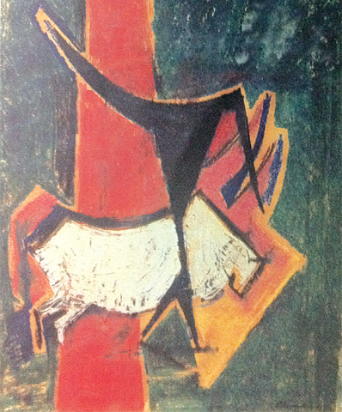
Man and the Bull

Slide 9
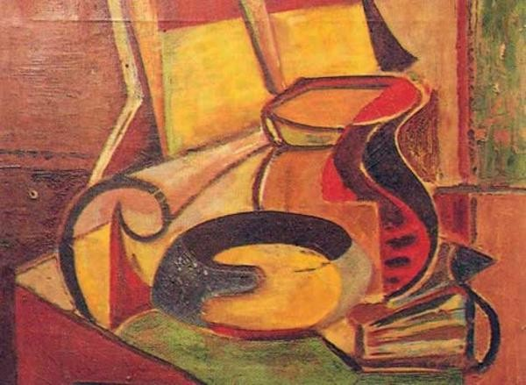
Still Life with a vase

Slide 10
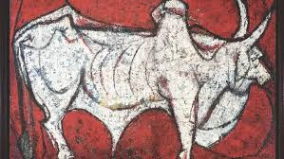
Bull

Slide 11
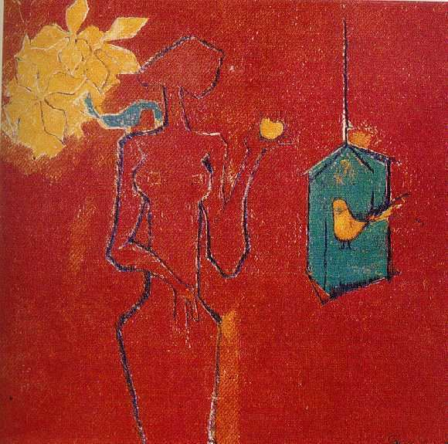
Lady with apple and bird

Slide 12
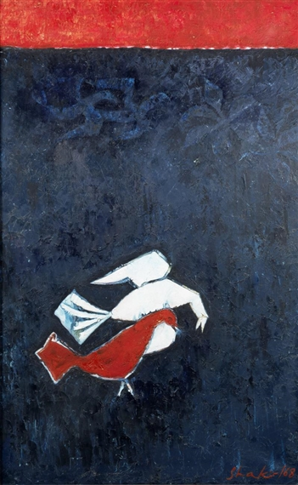
Birds

Slide 13
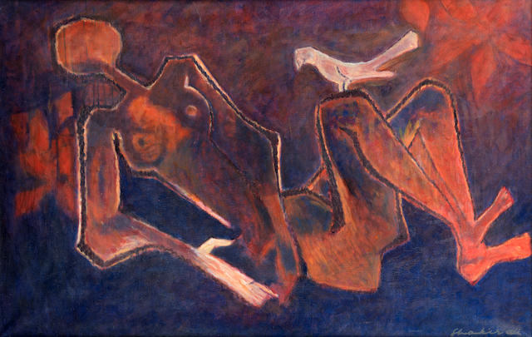
Lady with a bird

Slide 14
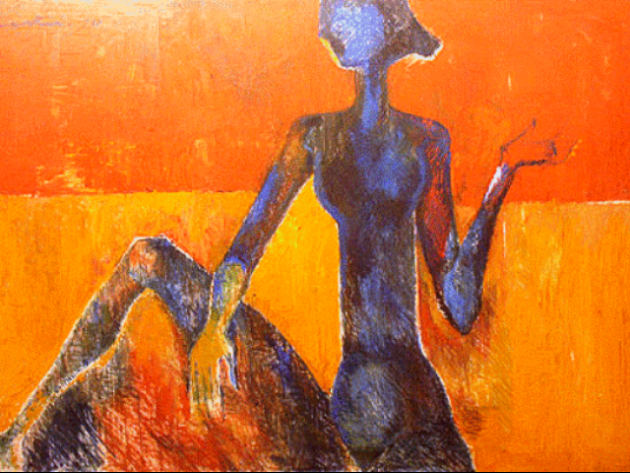
Untitled

Slide 15
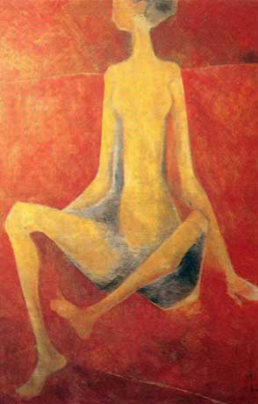
Untitled

Slide 16
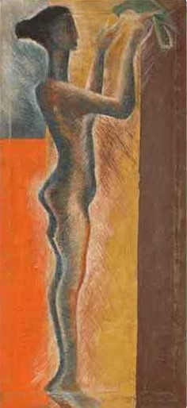
Lady with a bird

Slide 17
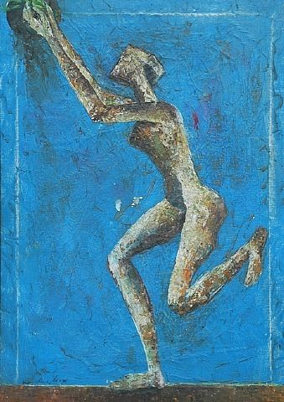
Untitled

Slide 18
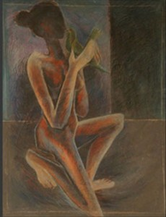
Untitled

Slide 19
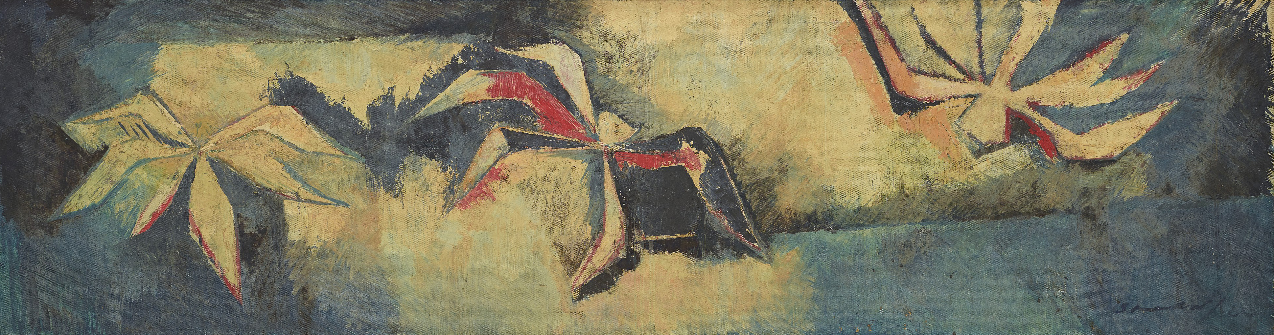
Untitled

Slide 20
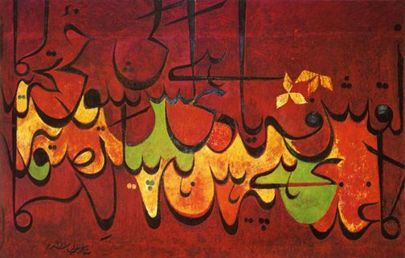
Calligraphic work by Shakir Ali

Slide 21
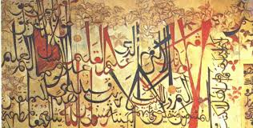
Calligraphic Mural Painting by Shakir Ali

Slide 22
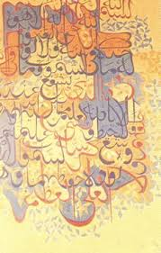
Calligraphic work by Shakir Ali

Slide 23
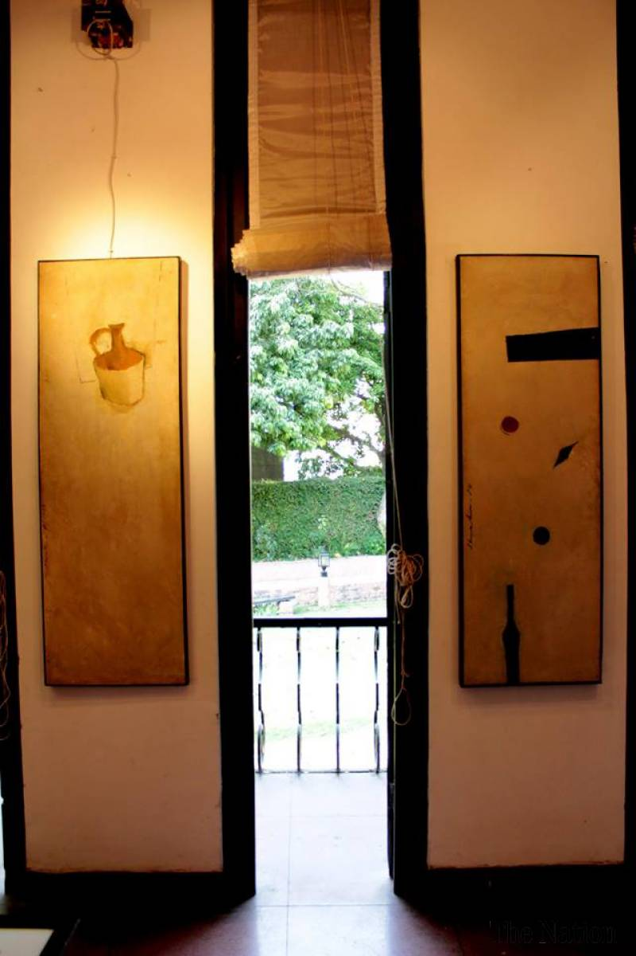
Still lives displayed at Shakir Ali Museum

Slide 24
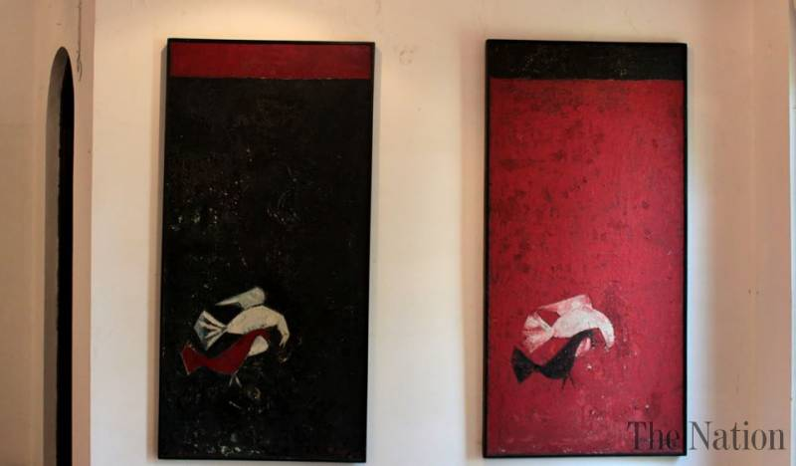
Paintings displayed at Shakir Ali Museum

Slide 25
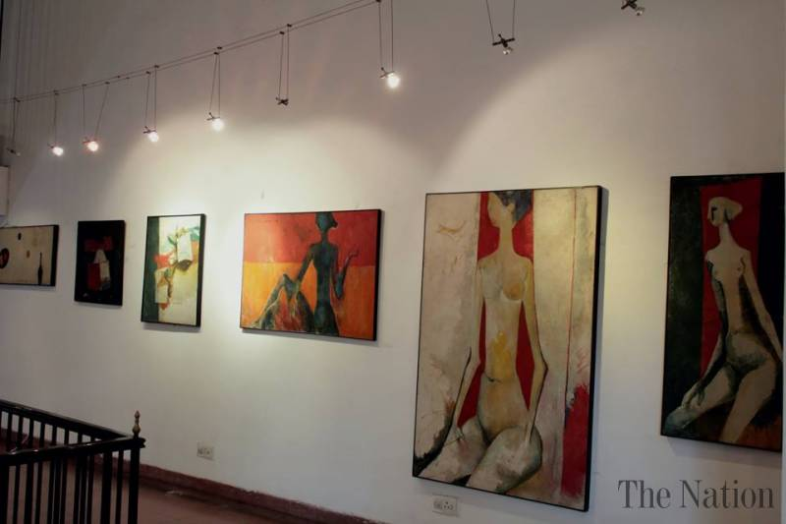
Paintings displayed at Shakir Ali Museum

